Slide 1

Market Basket Analysis
By Anshika

Slide 2

Problem Statement
We will be analyzing how to convert the consumer tastes and preferences into
Association rules that are more insightful and actionable, from business perspective. For example, if customers buy product A they also tend to buy product typically we can extract the relationship between products in the form of rules or we can say is the purchase of bread leads to the purchase of butter?

Slide 3
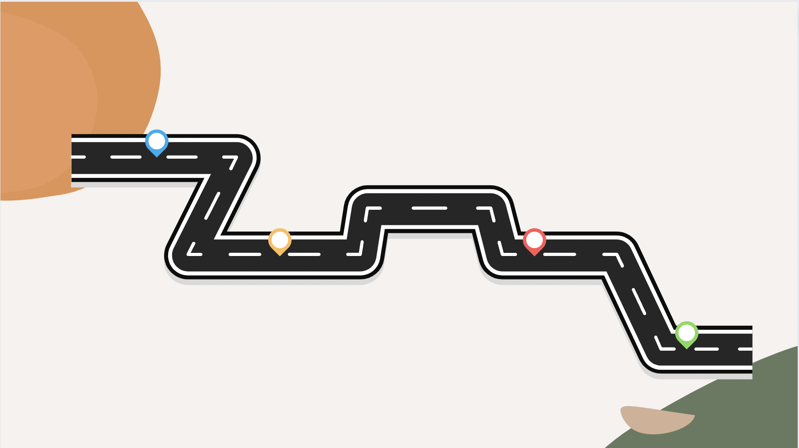
Data Pipeline
DATA-EXTRACTION-The dataset that is used in this project
is publicly available from Kaggle
DATA-VISUALIZATION- Build time series
chart for analysis
DATA-MINING-
generate association
the rules
DATA PRE-PROCESSING-There are 21,293 rows and 4 columns in the data frame, missing values are checked
Using the popular missing value ,combined the date &
Time columns into a single datetime column, convert it
Into datetime64 type, and then set it as datetime-index.

Slide 4

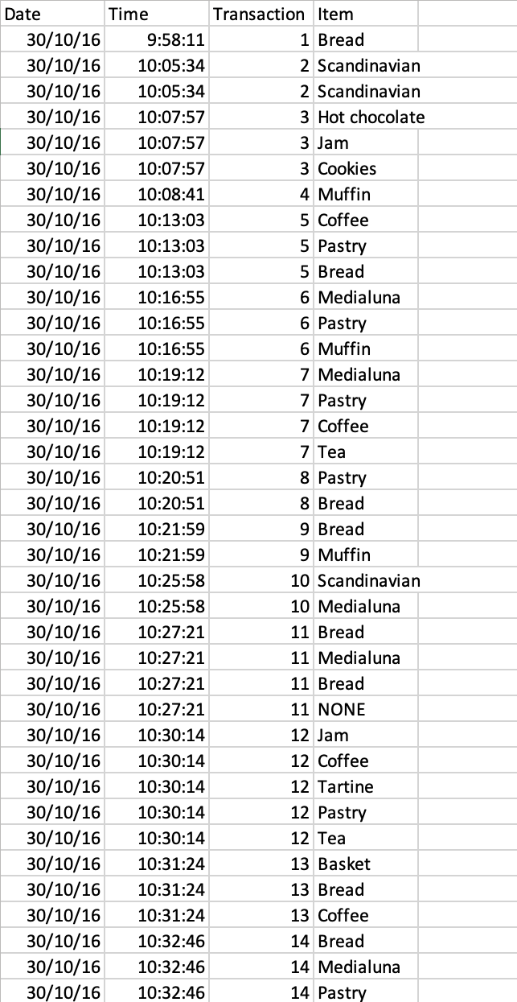
Attributes, Dataset and Libraries
This is the bakery data with the list of items bought by customers. which contains the Transactions data from a bakery from 30/10/2016 to 09/04/2017.
Transaction id
List of items
Date and time
Libraries
NumPy
Pandas
Matplotlib
Apriori
Association rules

Slide 5
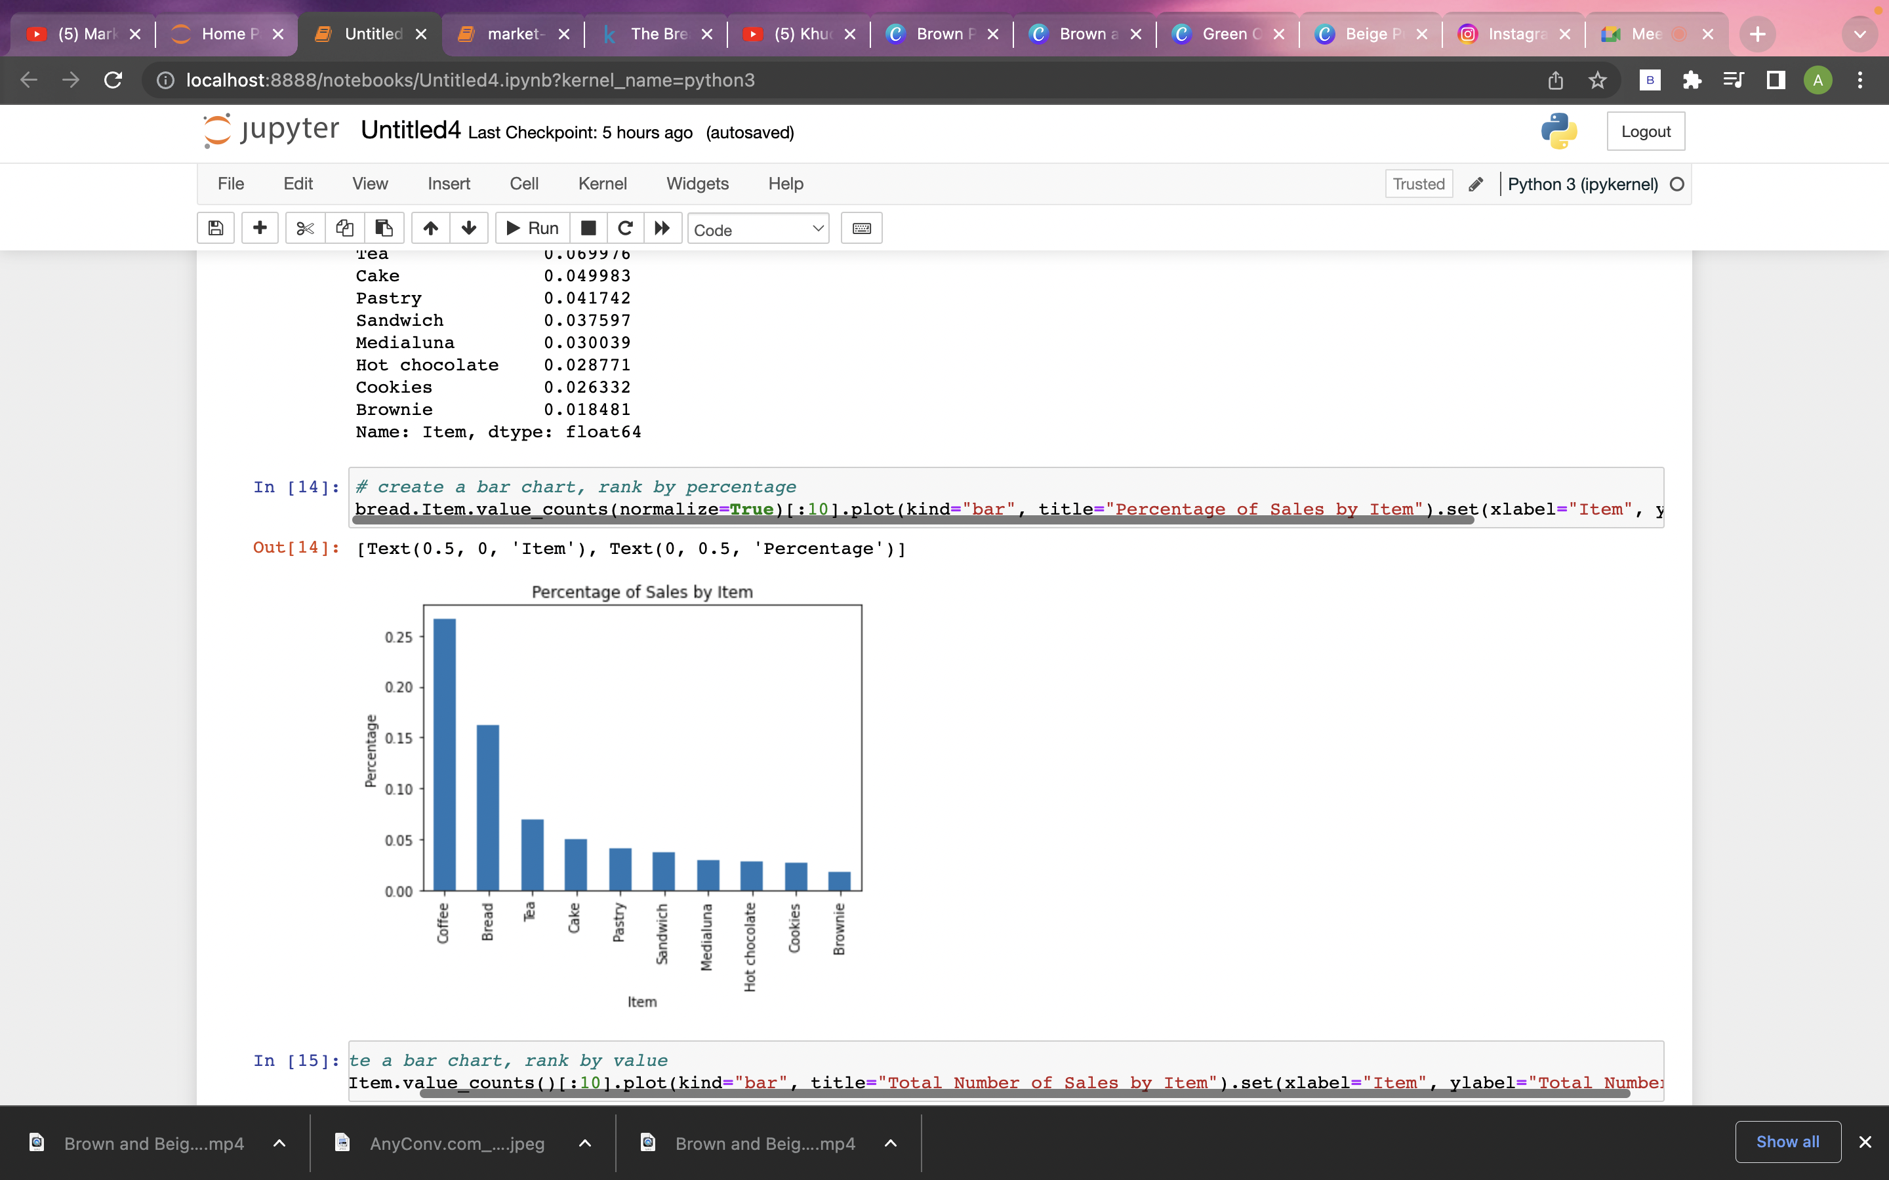
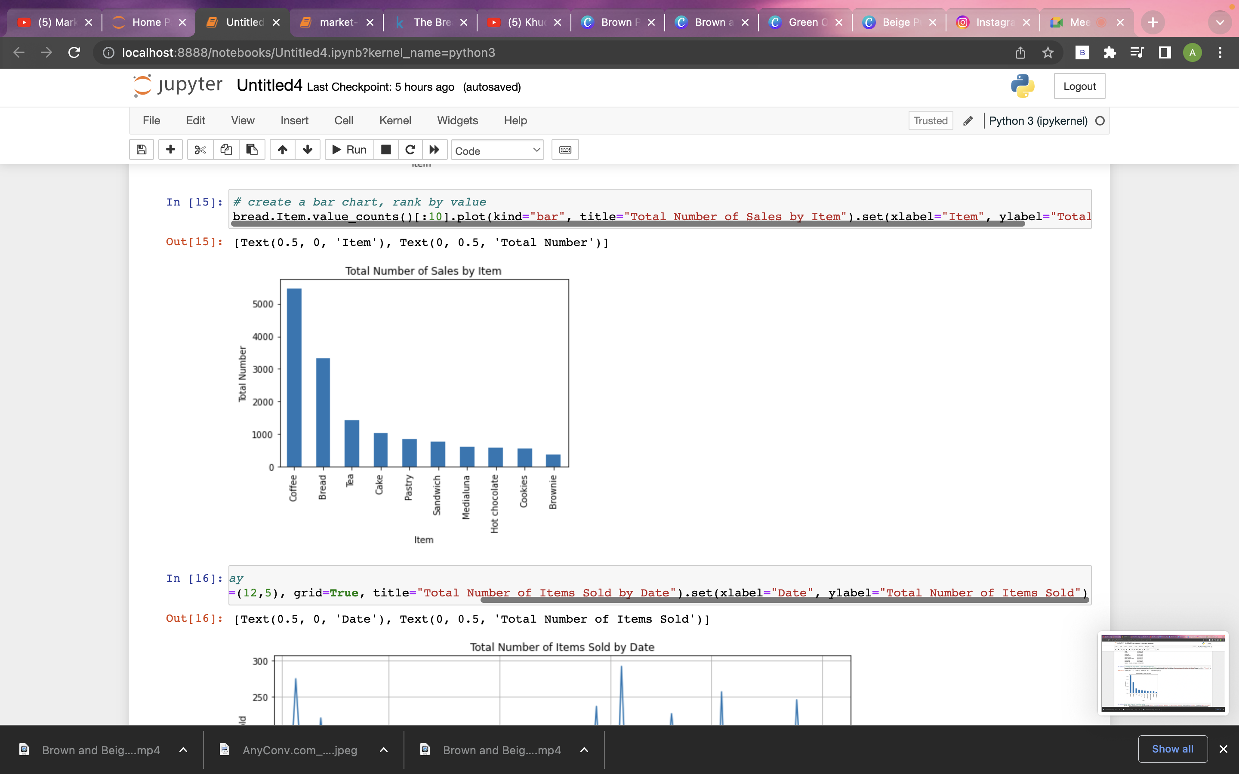
Top 10 Best-selling Items By Percentage And Value

Slide 6
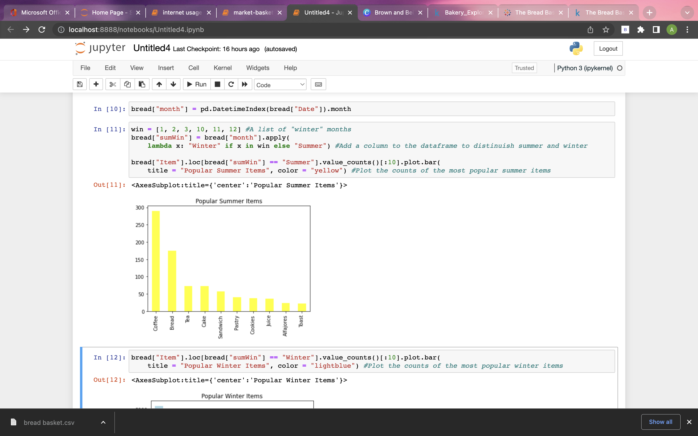
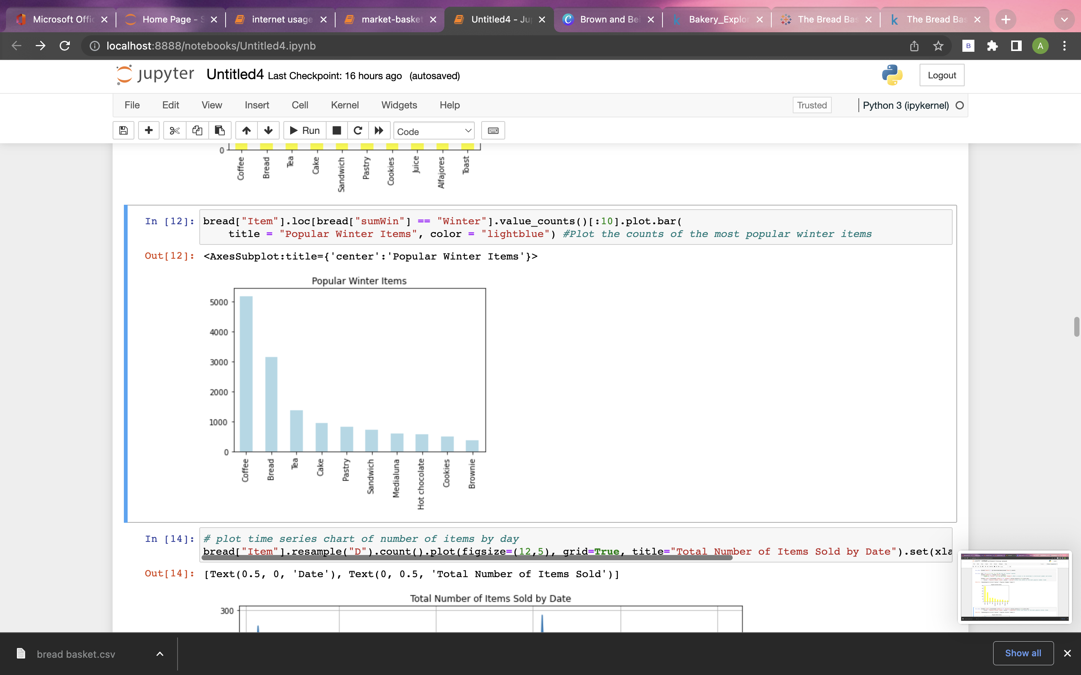
Top 10 Popular Items In Summer And Winter

Slide 7

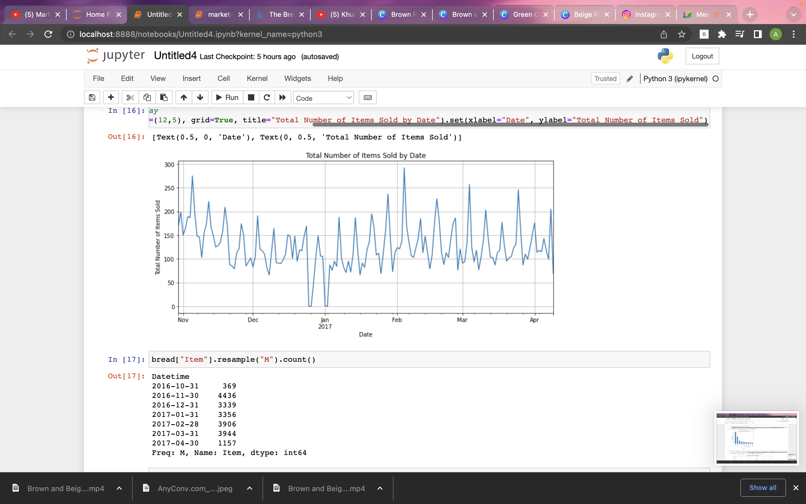
Time Series Chart Of Number Of Items By Day

Slide 8
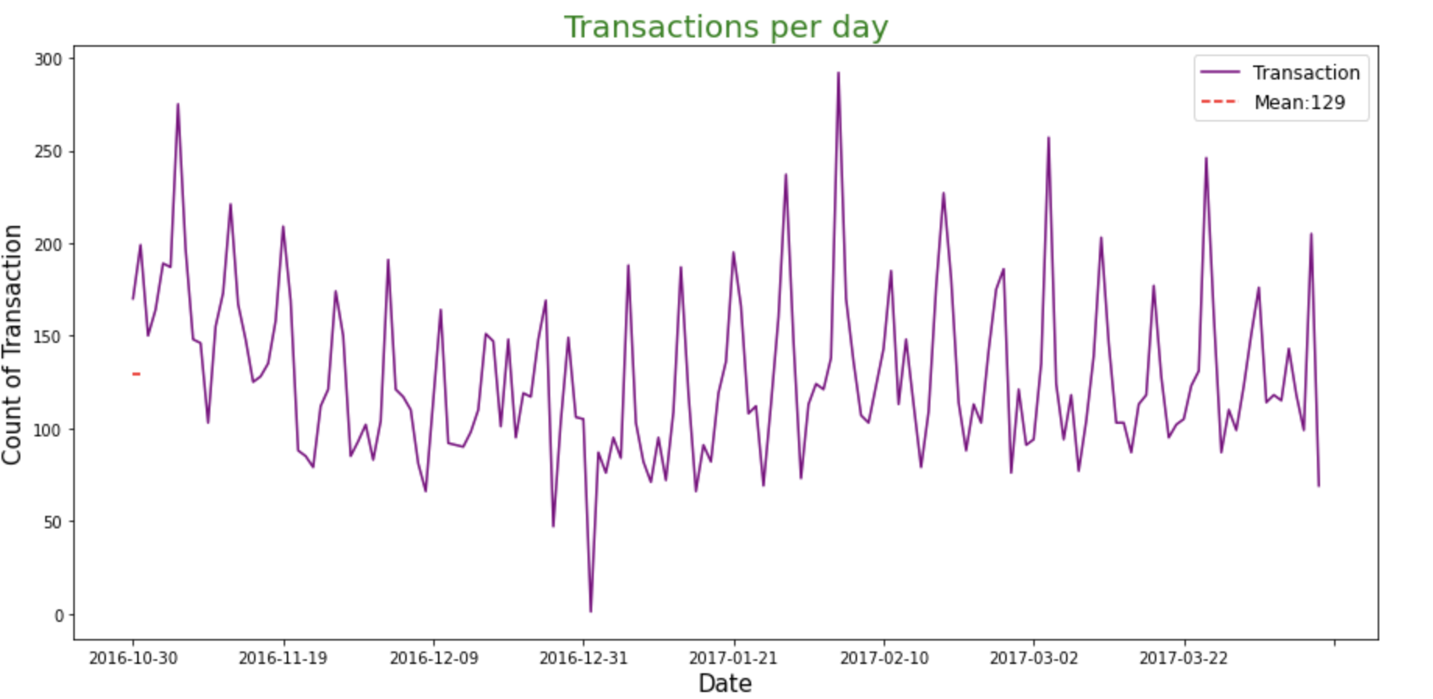
Time Series Chart Of Transaction Per Day

Slide 9
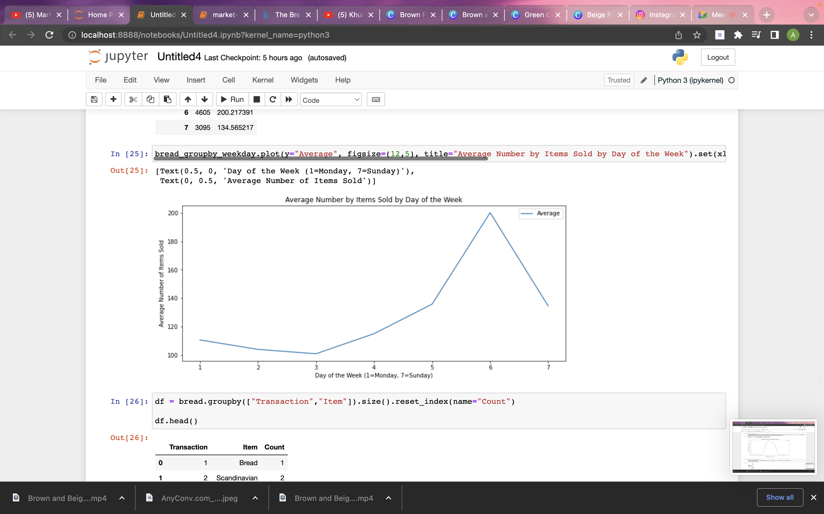
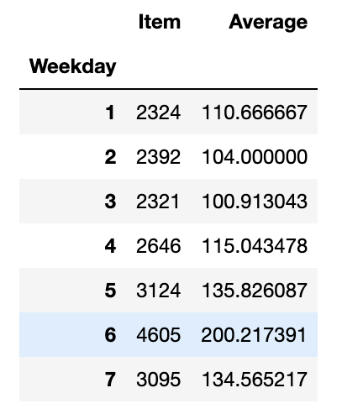
Time Series Chart Of Number Of Items Sold On Weekday

Slide 10
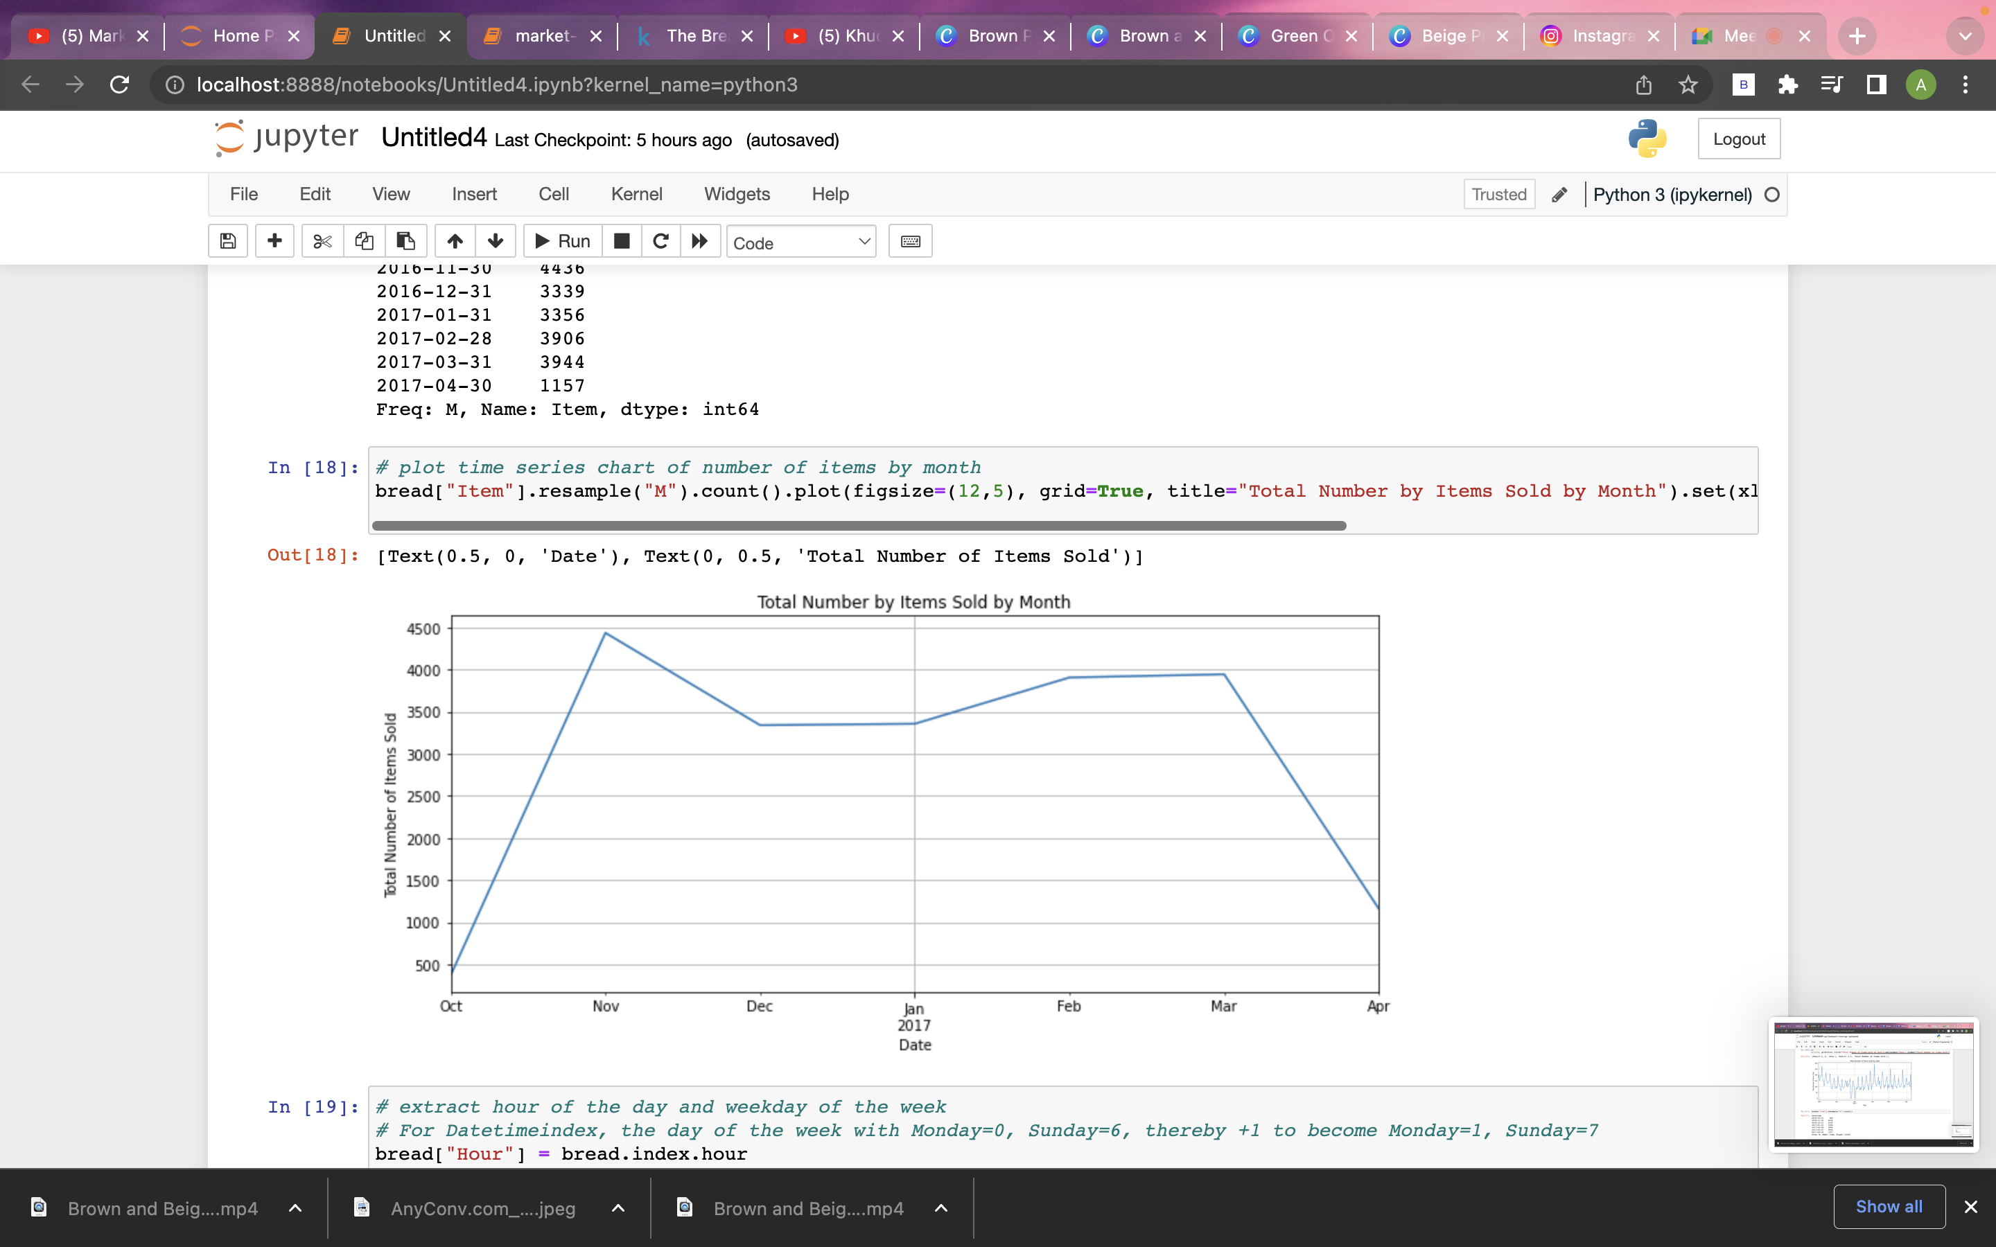
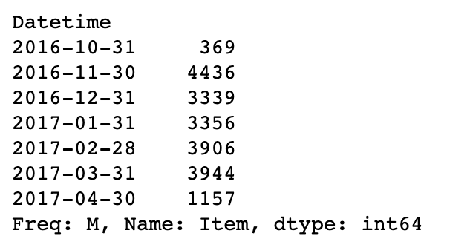
Time Series Chart Of Number Of Items By
Month

Slide 11
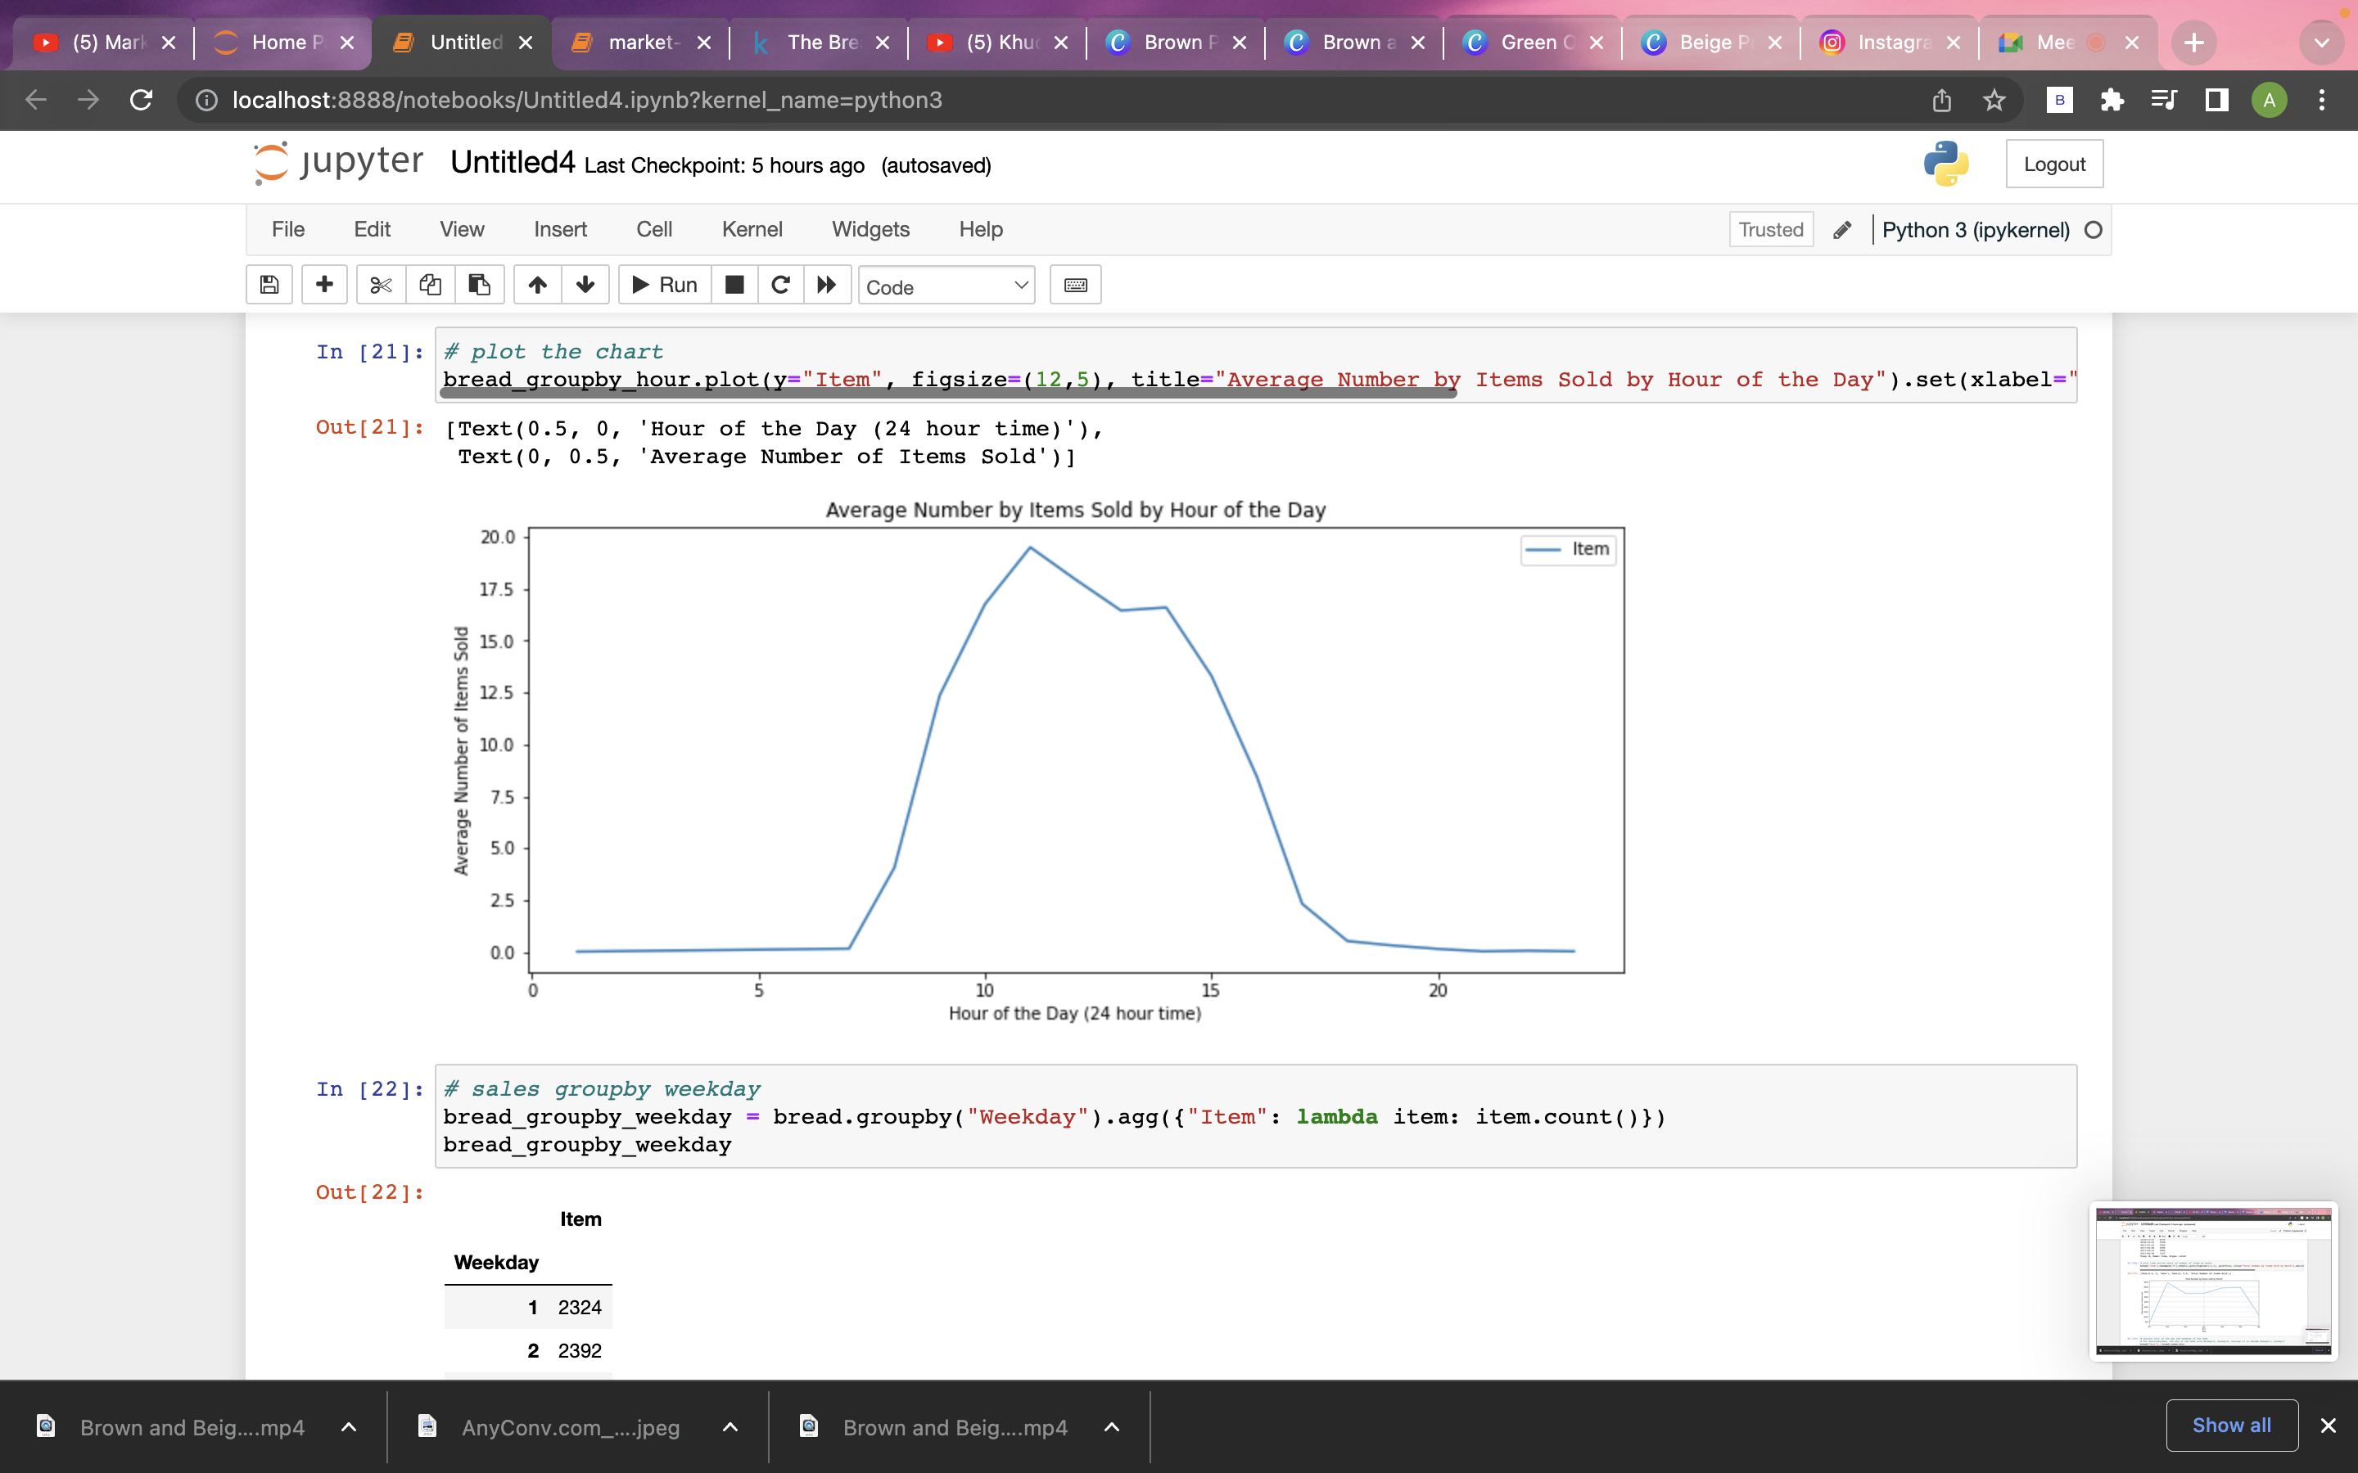
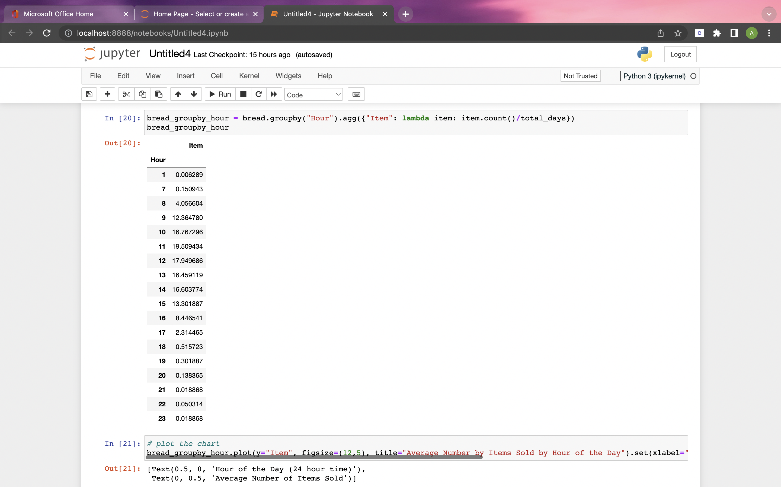
Time Series Chart Of Average Number Of Items
By Hour

Slide 12
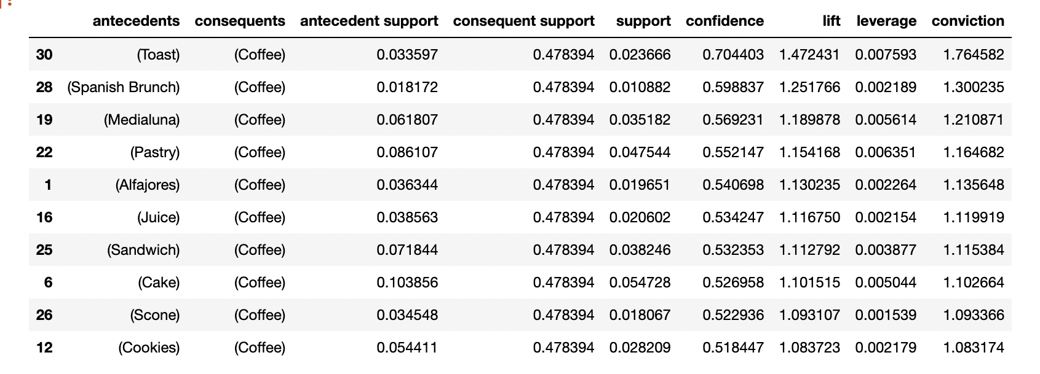
Generating Association Rules-MBA Analysis

Slide 13
Interpretation And Implications
The output above shows the top 10 itemset sorted by confidence value and all item sets have support value
Over 1% and lift value over 1. The first itemset shows the association rule "if toast then coffee" with support
Value at 0.023666 means nearly 2.4% of all transactions have this combination of toast and coffee bought
Together. We also have 70% confidence that coffee sales happen whenever a toast is purchased. The lift
Value of 1.47 (greater than 1) shows that the purchase of coffee is indeed influenced by the purchase of
Toast rather than coffee's purchase being independent of toast. The lift value of 1.47 means that toast’s
Purchase lifts the coffee's purchase by 1.47 times. Therefore, we can conclude that there is indeed evidence
To suggest that the purchase of toast leads to the purchase of coffee. The owner of the bakery
"the bread basket" should consider bundling toast and coffee together as a breakfast set or lunch set, the
Staff in the store should also be trained to cross-sell coffee to customers who purchase toast, knowing that
They are more likely to purchase them together, thereby increasing the store's revenue.

Slide 14
Tableau Dashboard

Slide 15
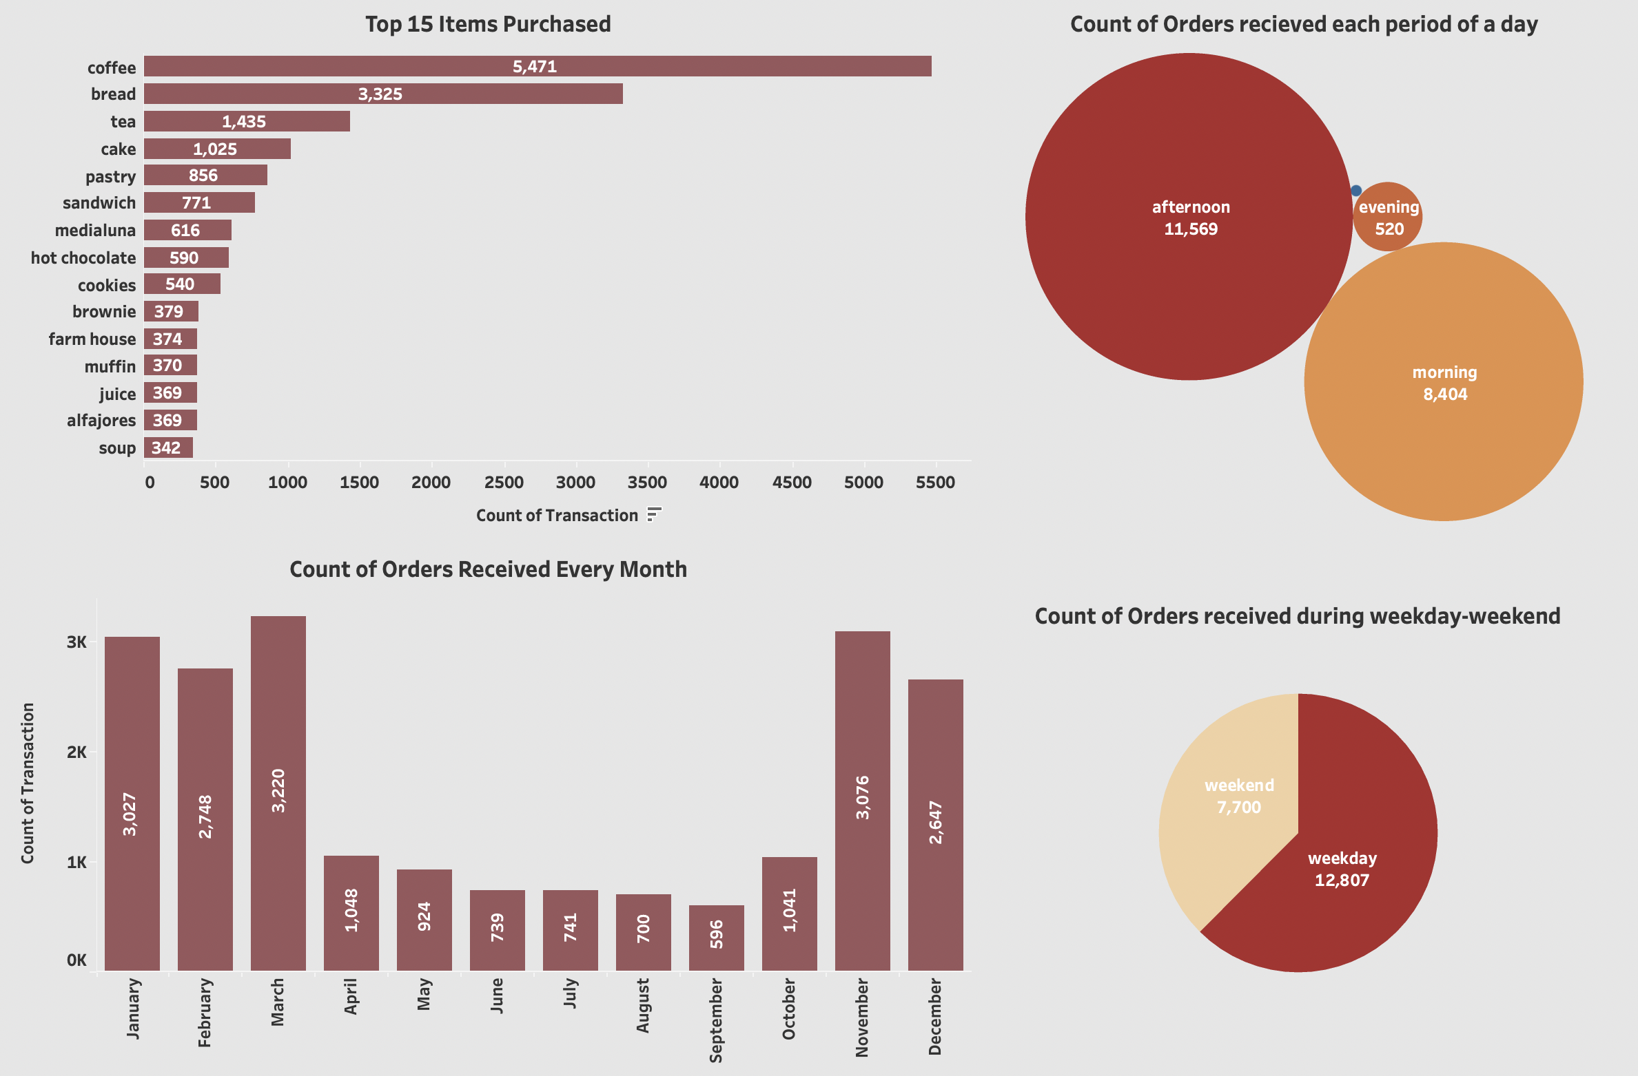

Slide 16
Analysis and Findings
There are three metrics or criteria to evaluate the strength or quality of an association rule, which are support, confidence and lift.
1. Support
Support measures the percentage of transactions containing a particular combination of items relative
To the total number of transactions.
Support (antecedent (x) and consequent (y)) = number of transactions having both items / total transactions.
2. Confidence
Confidence measures the probability of finding a particular combination of items whenever antecedent is
Bought.
Confidence (antecedent(x) and consequent(y)) = p (consequent (y) is bought given antecedent (x) is bought.
3. Lift
Lift is a metric to determine how much the purchase of antecedent influences the purchase of consequent.
In probability terms, we want to know which is higher, p (butter) or p (butter / bread)? If the purchase of
Butter is influenced by the purchase of bread, then P (butter / bread) will be higher than P (butter), or in
Other words, the ratio of P (butter / bread) over P (butter) will be higher than 1.

Slide 17
Conclusion and Future Scope
Benefits of market basket analysis. Market basket analysis can increase sales and customer satisfaction.
Using data to determine that products are often purchased together, retailers can optimize product placement,
Offer special deals and create new product bundles to encourage further sales of these combinations. The goal
Of market basket analysis is to understand consumer behaviour by identifying relationships between the items
That people buy. It supports the retail sector in all areas, from predicting sales success to locating customers.

Slide 18

Thanks!
Any Questions?

